Slide 1
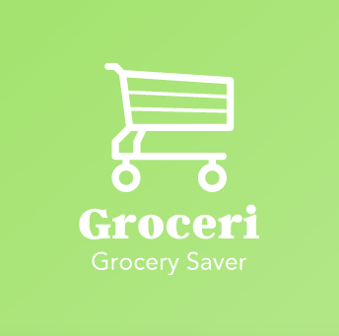
Michael Barte
Jordan Hsieh
Adolfo Alarcon
Peter Epsteen
Josh Richards

Slide 2
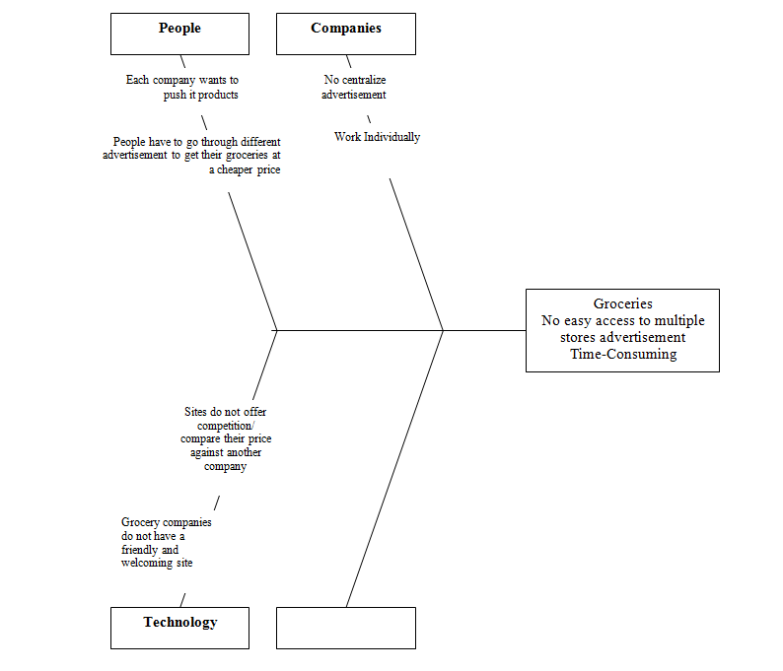
Old Ishikawa Diagram
Notes:
Old Ishikawa diagram shows a broad version of the goal. With no specific details, however it demonstrate the start of the project with some knowledge towards a new goal.

Slide 3
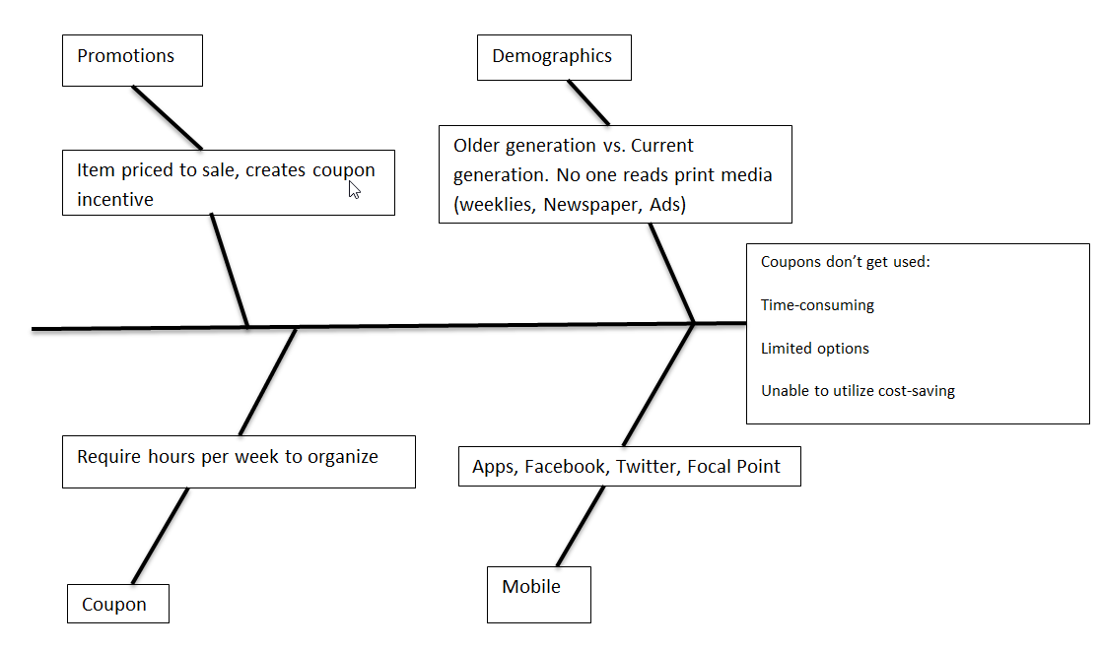
Ishikawa Diagram
Notes:
With the teachers comments/criticisms, we attempted to make our Ishikawa Diagram more focused with a clearly defined problem; coupons not being used. We also simplified the other compounding problems, distilling them down.

Slide 4
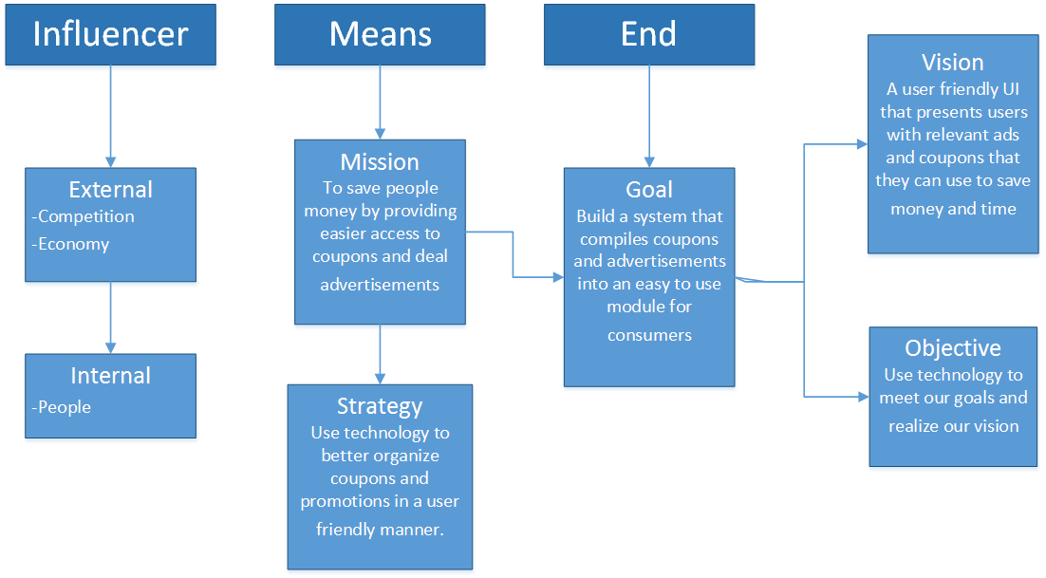
Business Motivation Model (BMM)
Notes:
Our Business Motivation Model aligns with our Ishikawa Diagram to show the problems we are trying to solve, and how we aim to do it.

Slide 5
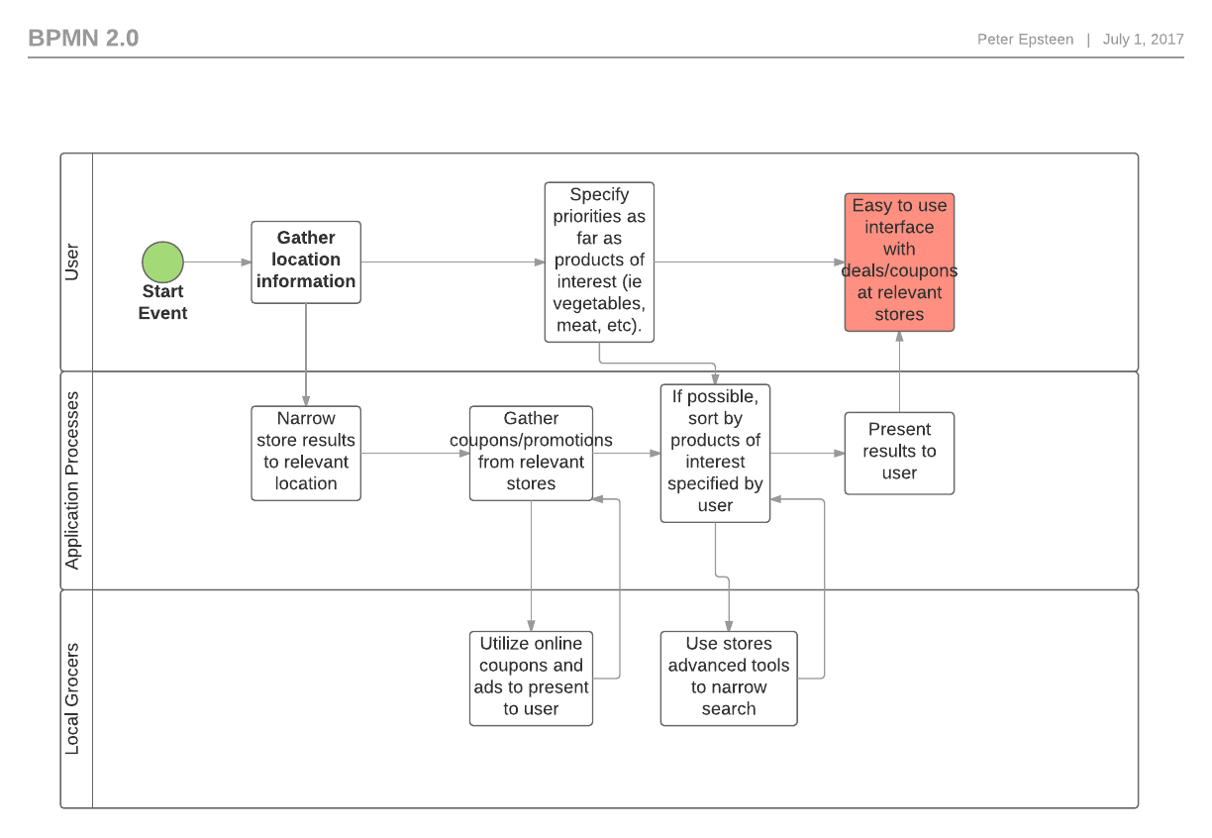
Business Process Model and Notation
Notes:
Gather information about the user’s location in order to determine optimal search results, match location to potential deals in database, also present users with local paid advertisements, filter by number of items per store, items of interest, preferred stores, then use this to present a result to the user. This results in a fast, easy to use coupon experience

Slide 6
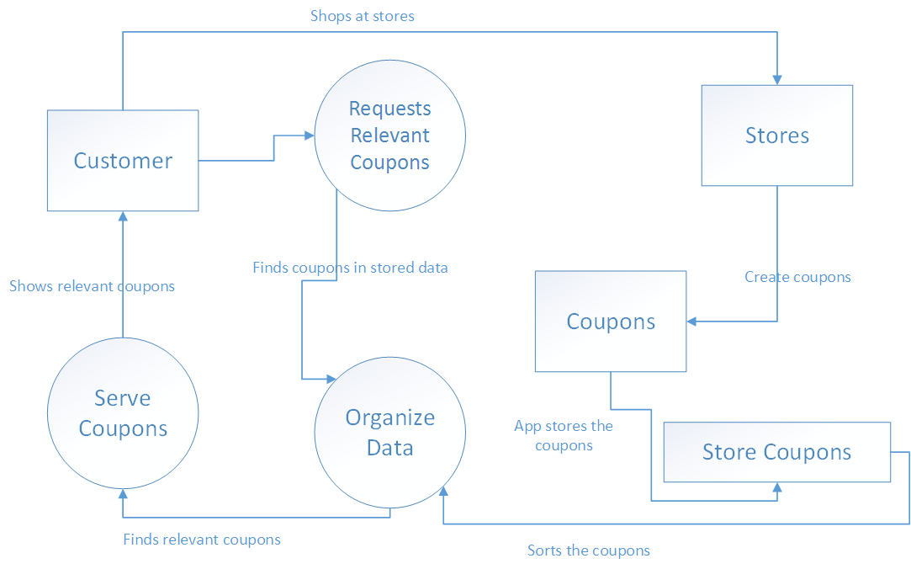
Data Flow Model
Notes:
Our Data Flow Model attempts to show our simple flow of the customer and store’s interaction with our data structure. The customer will be requesting a certain set of coupons, while the stores will provide our database with all of their current promotions.

Slide 7
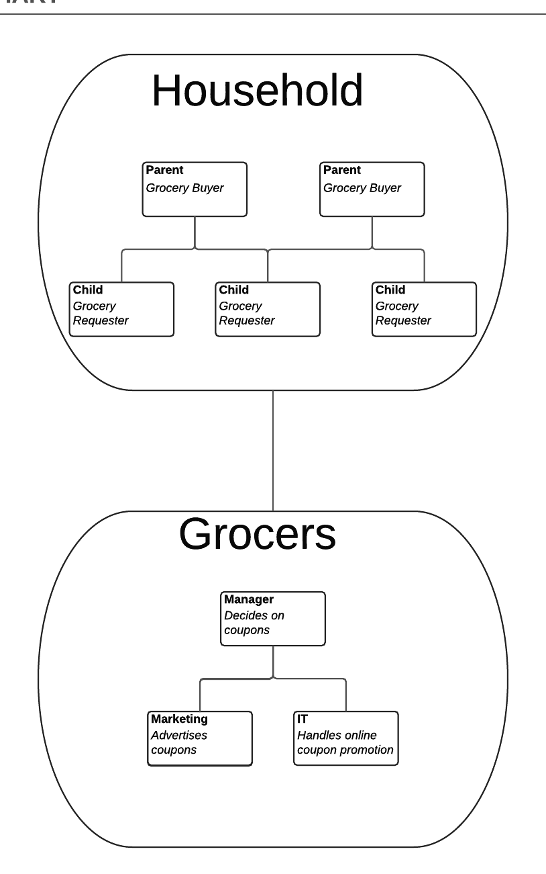
ORGANIZATION CHART
Our platform will link the household to the grocer. The household organization will center around our “Grocery List” features. The Grocer will work with their team to provide our database with coupons. This will enable the household to find the cheapest coupons for their needs.
Notes:
At first, we made the mistake of making an internal organization chart. After reviewing with the professor, we revised it to show how we will be linking the household structure with the grocery store organization.

Slide 8
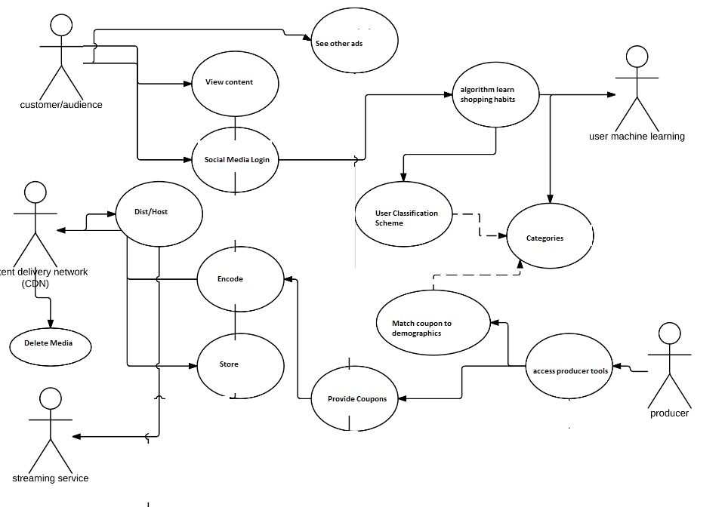
USE CASE
Notes:
The customer will be able to view coupons and also advertised coupons which will teach an AI to recommend the correct ADS. The producer is able to upload coupons which are stored in a database and distributed to users. Our software will allow the two to better match up, so stores coupons are better utilized, which benefits both the consumer and the grocer.

Slide 9
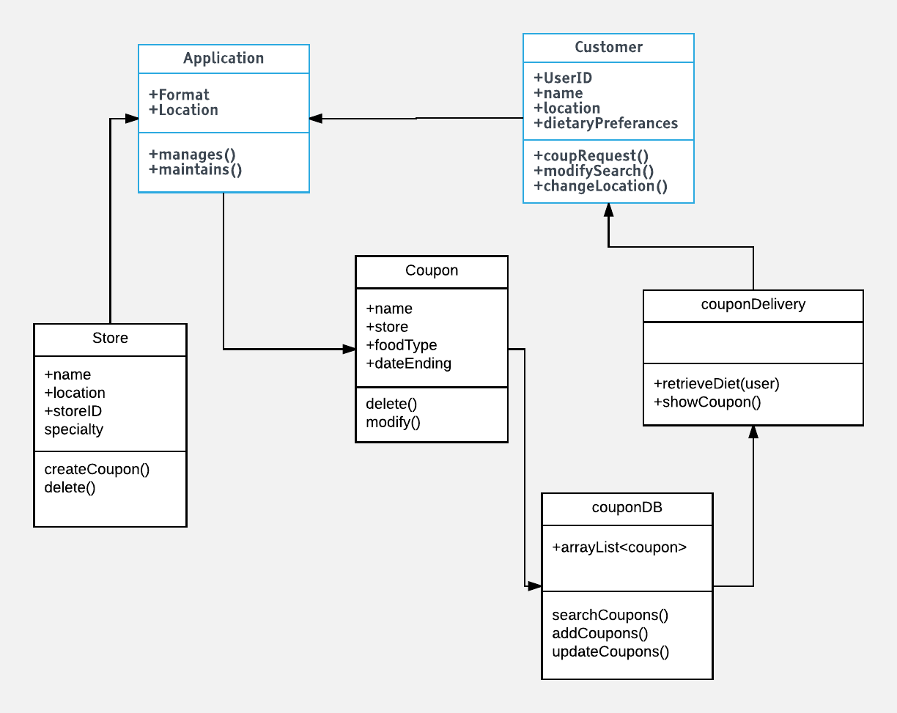
Class Diagram
Notes:
Our class diagram shows the various classes that will be used in our software, and the accompanying actions that will be performed.

Slide 10
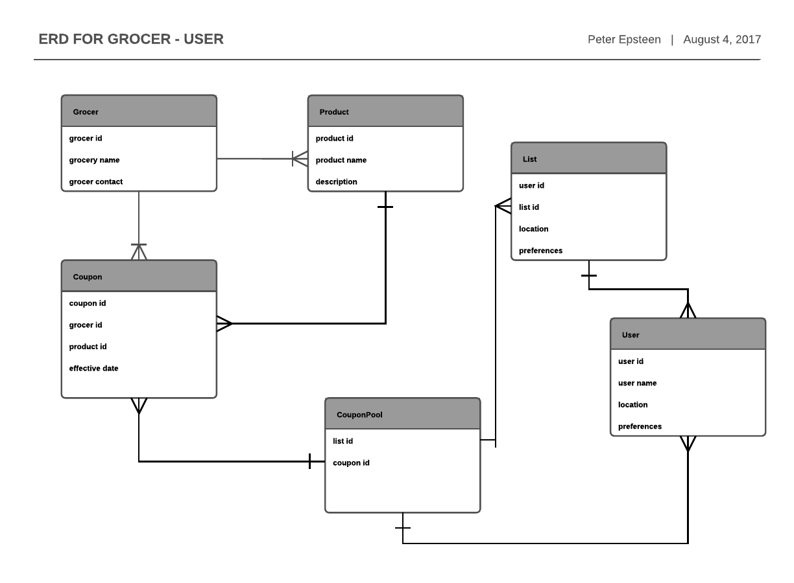
ERD
Notes:
We kept our ERD simple as we aimed to leave it general so that we could adapt it as needed when we furthered our development of our idea.

Slide 11
User Interface
Live App Demo
Notes:
This demo shows our vision for how we would like our software to look and feel. We aimed to keep it user friendly, which will encourage our users to keep using the app. Click the link to see the demo.

Slide 12
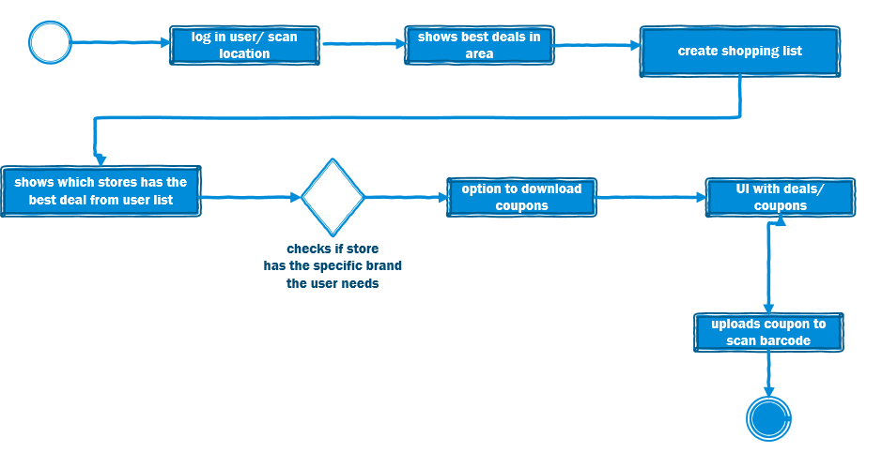
Activity Diagram
Notes:
This diagram shows our streamlined vision of how a user would utilize our app. They simply log in, create a list, and let the app do the work in matching up the best deals for them.

Slide 13
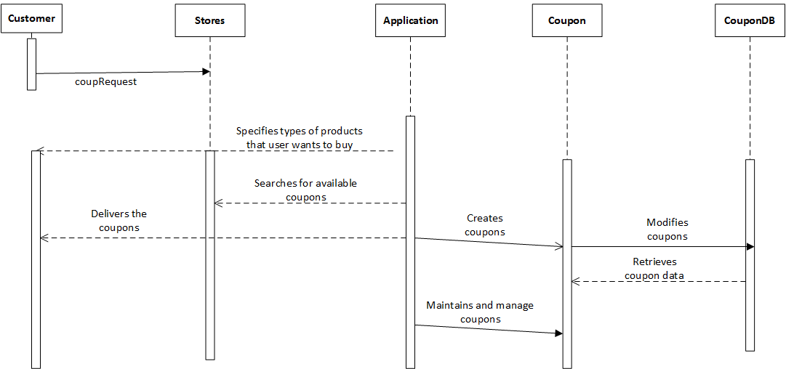
Sequence Diagram
Notes:
This diagram aims to show how our users and application interact to form the entire sequence.

Slide 14
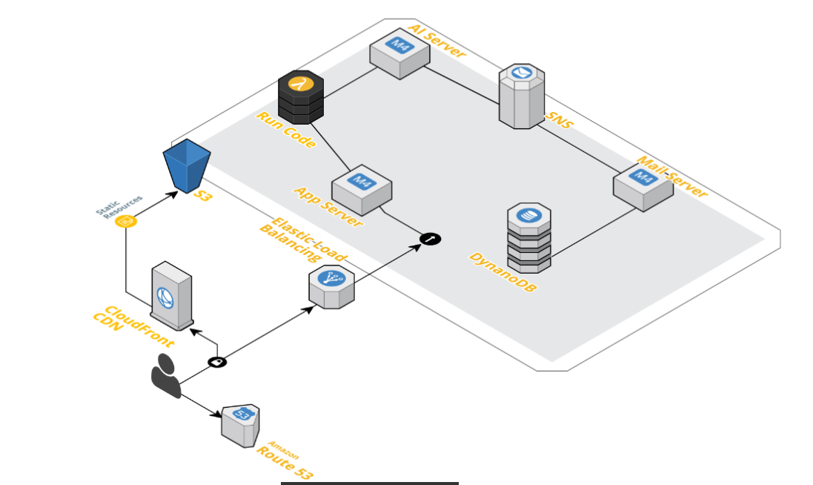
AWS Diagram
Notes:
Our network diagram shows how we will be using Amazon Web Services to handle all of our backend functionality.

Slide 15
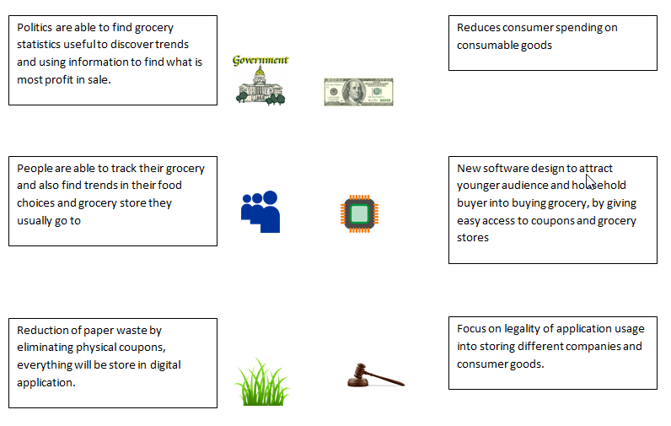
PESTLE
Notes:
Using PESTLE, we show how our app fits into the current economy and environment. It aims to improve quality of life on all fronts, primarily through saving people money, and making grocer’s promotions better utilized.

Slide 16
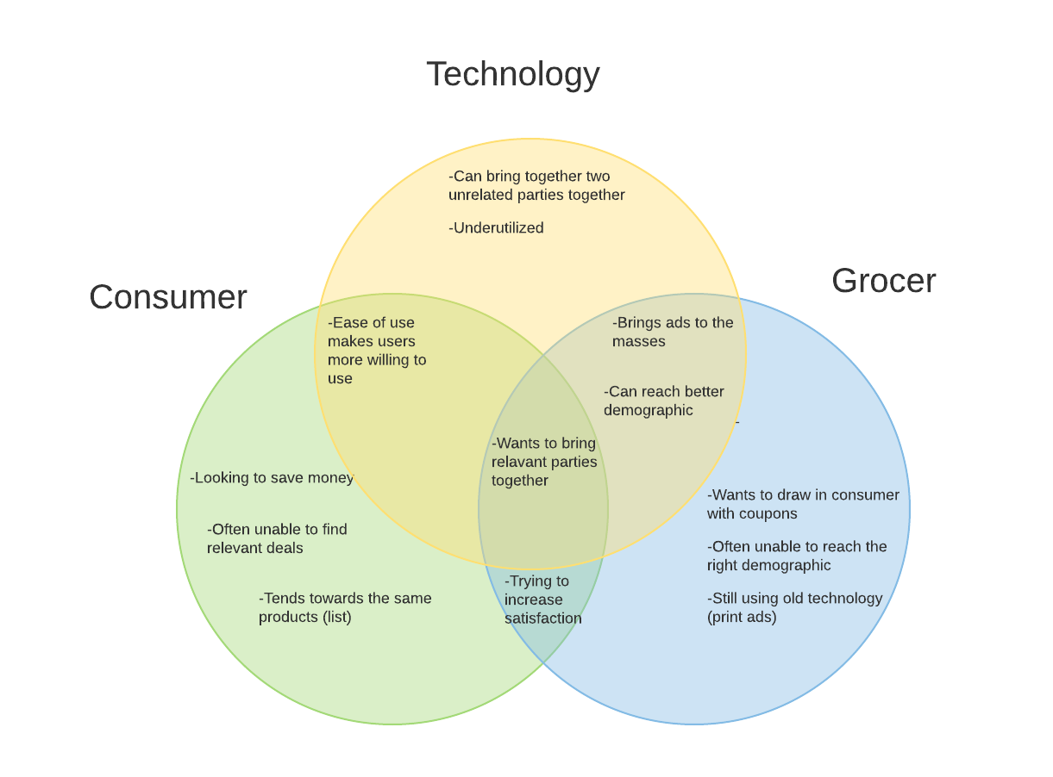
Venn Diagram
Notes:
Our venn diagram shows how our software will bring together consumer, grocers, and technology. We believe the goals of all of these parties can be aligned with an app such as ours.

Slide 17
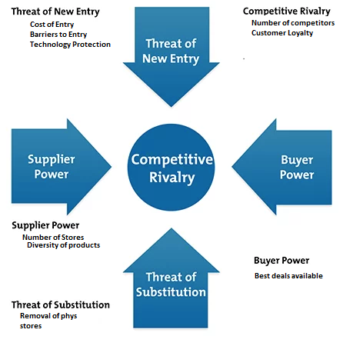
Porter’s Five Forces
Notes:
The threat of new entry is barriered by the cost of infrastructure and proprietary rights to a coupon sorting algorithm. Competitive rivalry is combated by customer loyalty and the lack of competition. Stores are plentiful thus there is not a lack of supply. If physical stores are removed coupons still will exist. Buyers get the ability to find the best deals on everyday grocery items close to them with the most convenience.

Slide 18
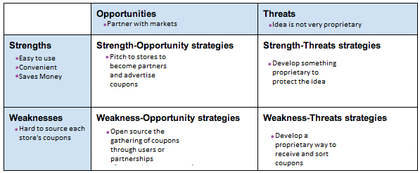
SWOT Analysis
Notes:
Our SWOT analysis shows how our app is well positioned in the market. It has the opportunity to use the weaknesses of the grocer-consumer relationship in order to form a better system.

Slide 19
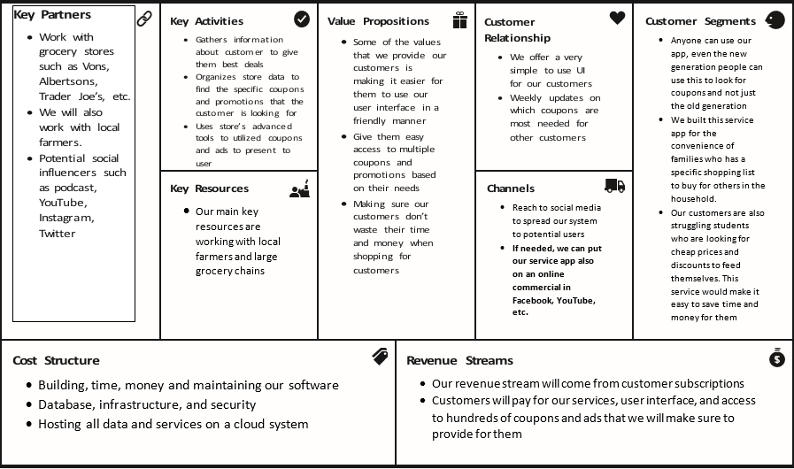
Business Model Canvas
Notes:
The business model canvas gave us a better perspective on how to better develop the business model for our software.. It gave us a better understanding of what resources we need, what type of customers are we getting and what they are looking for in our software. It also gave us an idea on how we can spread our service throughout social media to gain potential customers. We discovered that there will be costs on maintaining, building, and hosting all the coupon data and services on a cloud system.

Slide 20
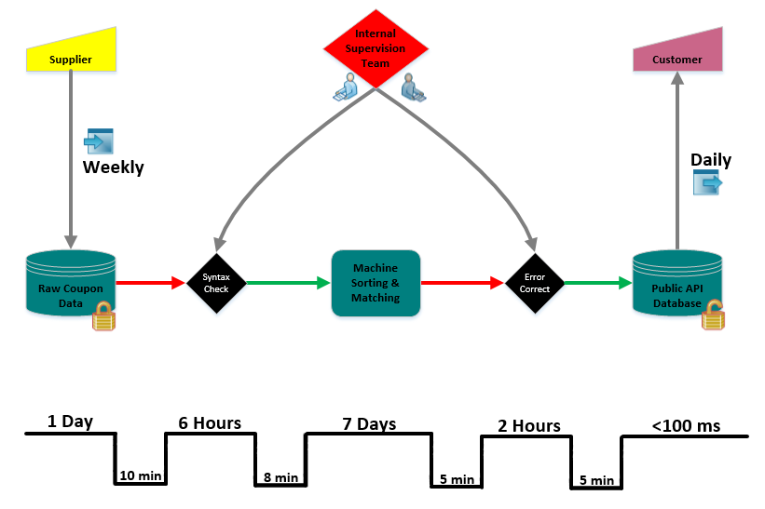
Value Stream Analysis
4
1 Hour
Notes:
A supplier will supply once a week a set of coupons for the entire week. Once a day, the set of coupons is uploaded to the sorting machine in order to determine the daily coupons and push them out to consumers. A internal team will monitor the data given to us from suppliers and also the data supplied by the machine sorting system to ensure integrity. Customers retrieve information via our public API. Time between steps is for file transfer, ideally the information becoming more optimized thus taking less time to transfer over the stages.

